Slide 1



Automatic Timetable Generator
Genetically inspired
Algorithm
Coding and computer expertise
Data & Visualizations

Slide 2

Automatic Timetable Generator
Automatic Timetable Generator

Slide 3
Automatic Timetable Generator

Slide 4

INTRODUCTION
Our Automatic Timetable Generator optimizes resource allocation, minimizes conflicts, and maximizes utilization for college courses.
Leveraging advanced algorithms and data analysis, the system efficiently handles complexities by collecting and processing key data—teacher availability, subject schedules, and classroom constraints.

Slide 5

LITERATURE REVIEW
The timetabling problem, acknowledged as NP-hard (Kong & Kwok, 1999), employs heuristic functions for enhanced scheduling performance.
Possible Solutions for this problem :
Genetic Algorithms and Memetic Algorithms by Mohd. Dain, Shaari, N. Gom, Bacheck (2001),
Semantic Web by Causmaecker , P.D (2002).
Parallel Hybrid Genetic Algorithm by Berger and Barkaouia (2002) for the vehicle routing problem, asserting its speed, cost-effectiveness, and competitiveness over traditional heuristics.

Slide 6
PROBLEM STATEMENT
The “Automated Timetable Generator for Schools & Colleges” project aims to automate scheduling, optimize resource allocation, and ensure constraint adherence, thereby streamlining operations and improving the academic experience.

Slide 7


OBJECTIVES
To Develop an Automated Timetable generation System.
To Optimize Resource Allocation for college courses.
To minimize Conflicts to enhance overall scheduling process.
To Efficiently Handle Complexities by collecting and processing key data.

Slide 8
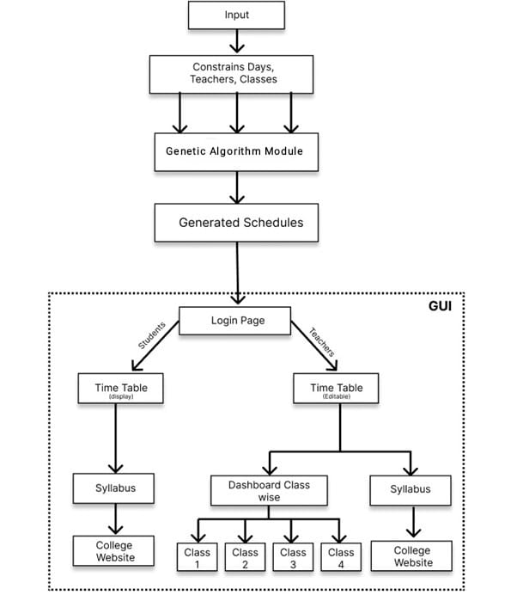

SYSTEM
ARCHITECTURE

Slide 9
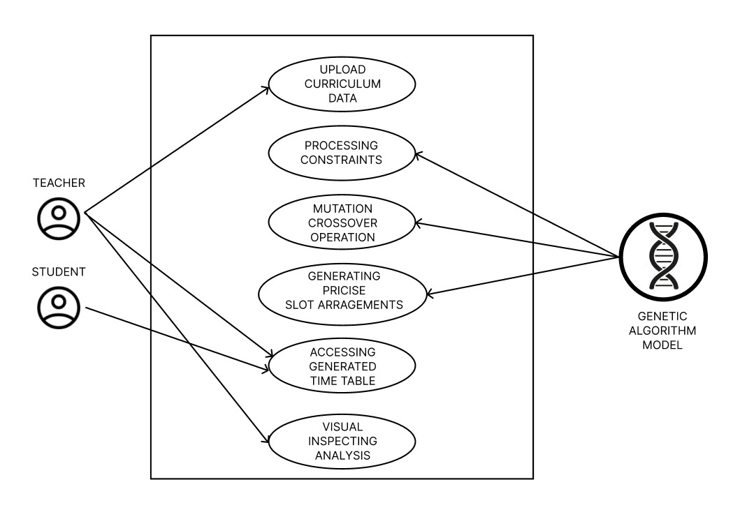

USE CASE
DIAGRAM

Slide 10
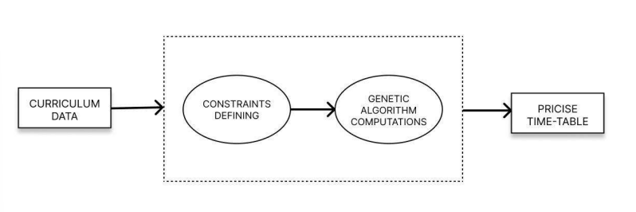
DFD LEVEL-0

Slide 11
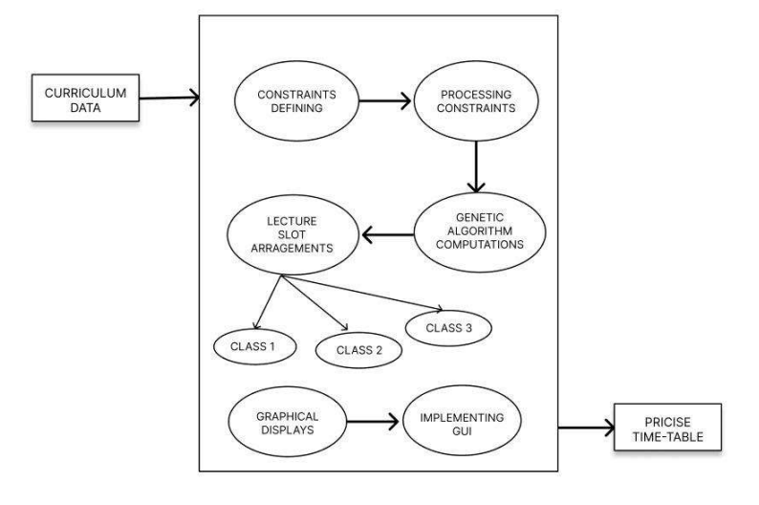
DFD LEVEL-1

Slide 12
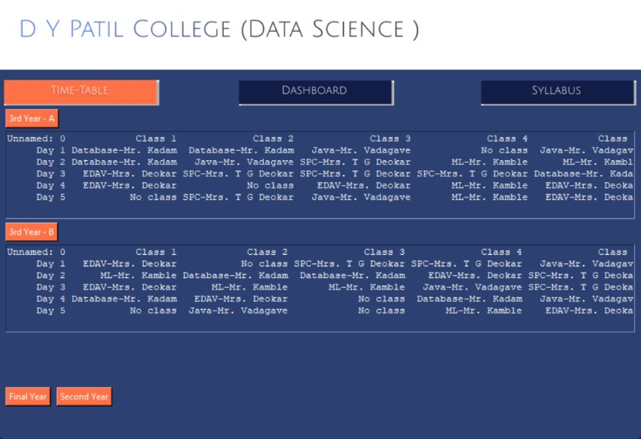
What We Propose …!

Slide 13
Can Be deployed on Multiple Classes
Teacher’s Interface

Slide 14
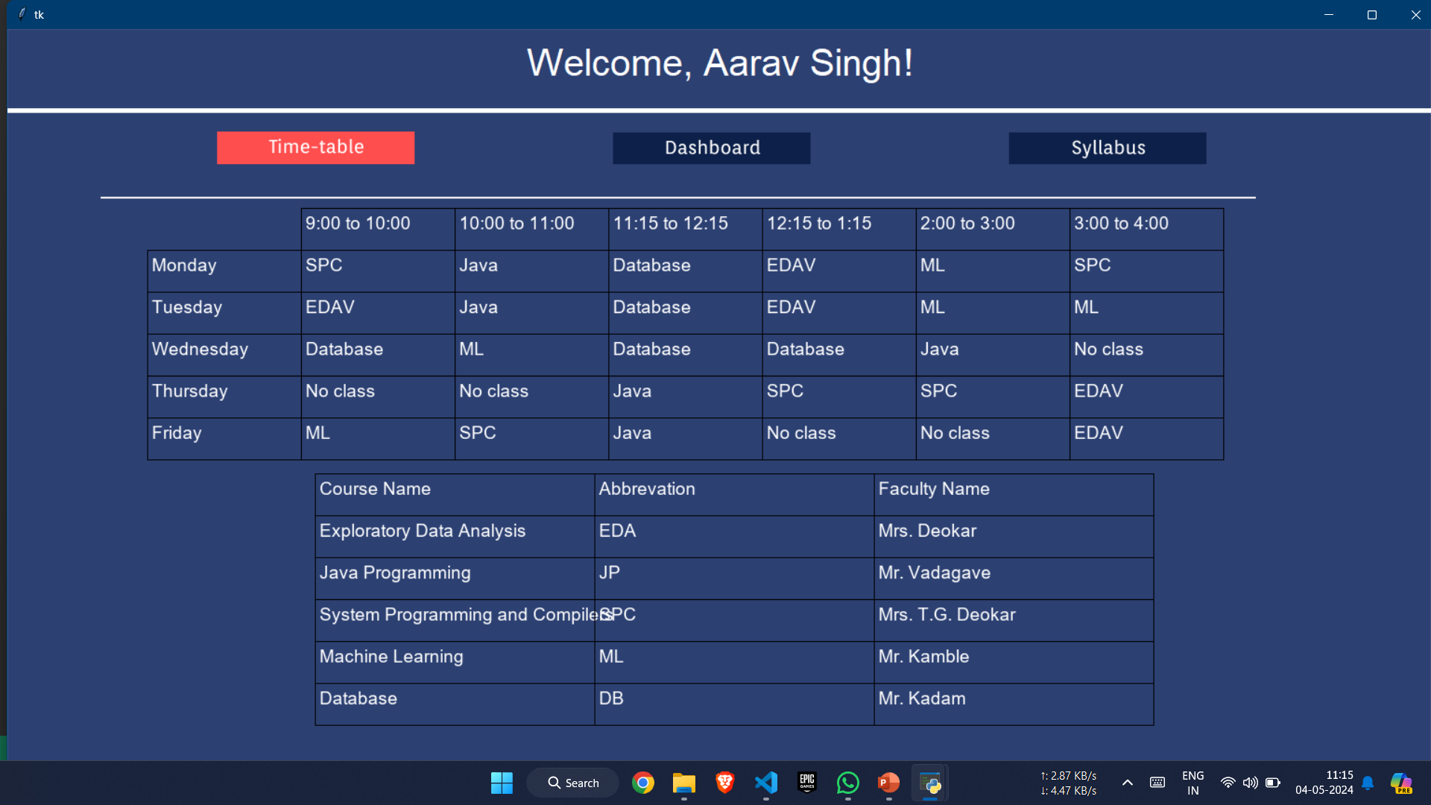
Have Different interface for student & Teacher
Student’s Interface

Slide 15
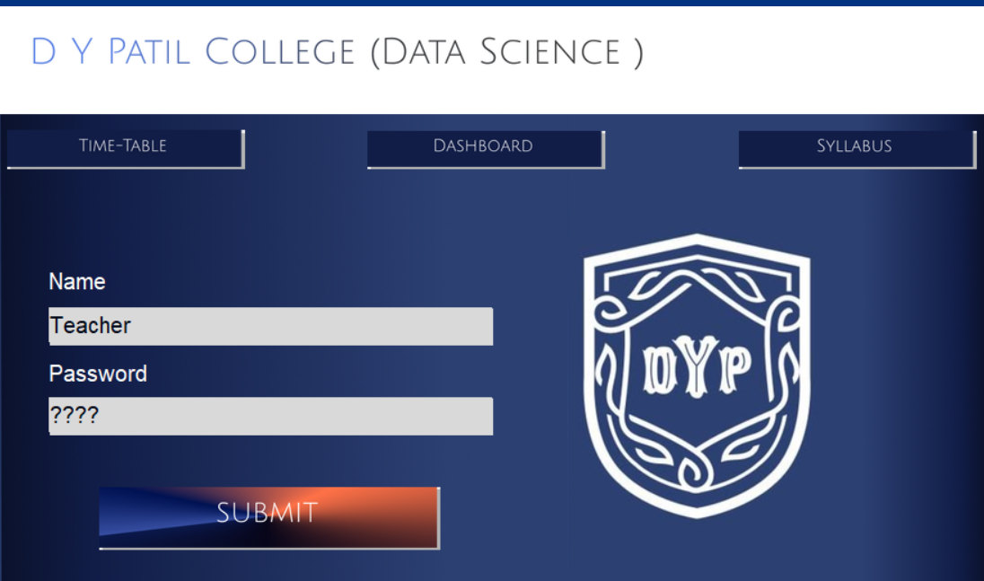
Password Authentication service

Slide 16
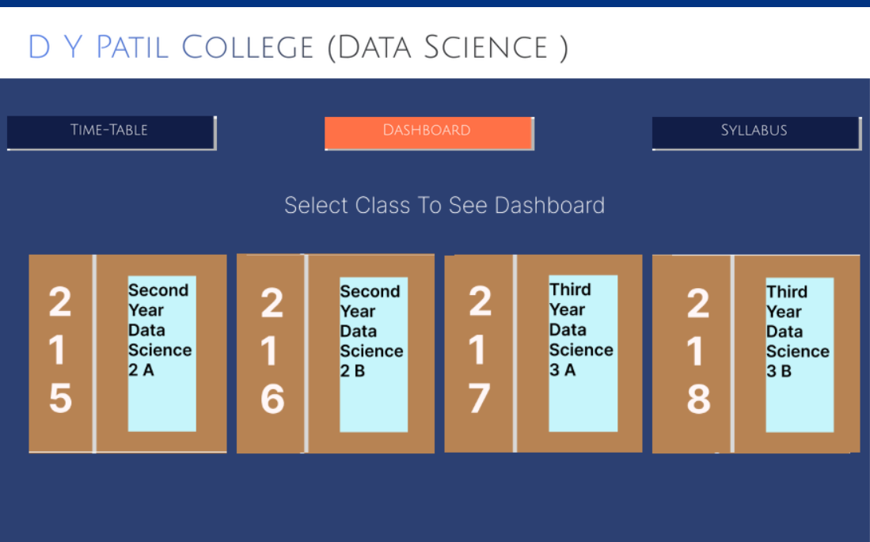
Class wise Schedule Analysis

Slide 17
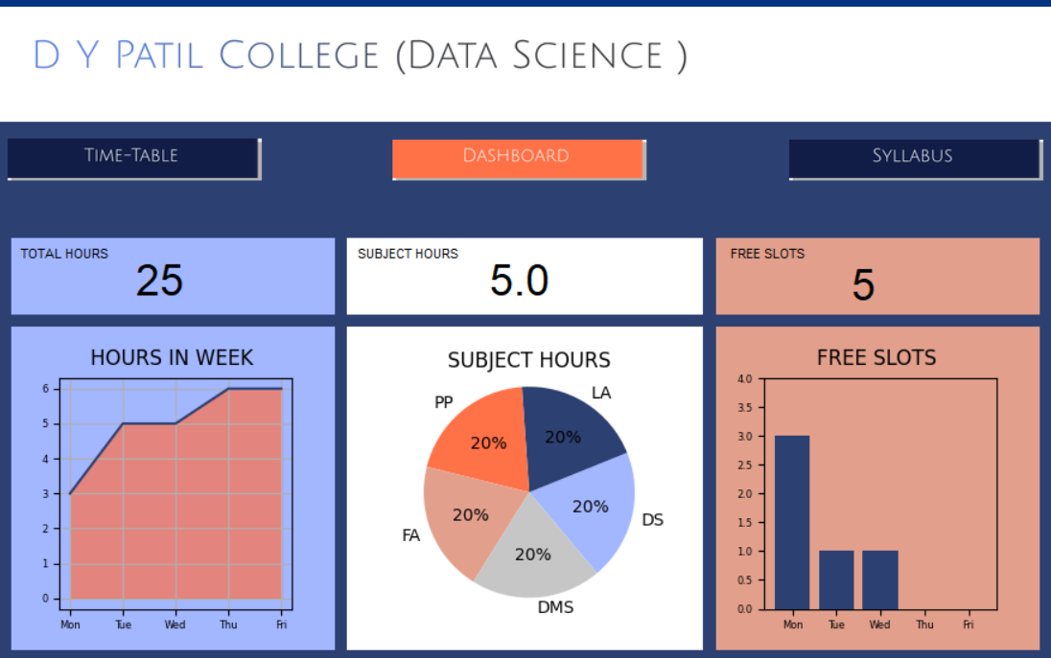
Integrated Dashboard

Slide 18
Total Hours
To understand the hours of teaching and syllabus completion

Slide 19
Distribution of Subjects as per week
To understand the priority of subjects based on importance in field

Slide 20
Free Slots in week
To plan the Extracurricular activities based on free slots

Slide 21
Conclusion
The Automatic Timetable Generator, driven by the genetic algorithm, represents a significant leap in scheduling efficiency. While improving user-friendliness and scalability, this project lays a foundation for automating resource allocation in college schedules, emphasizing the potential in usability and adaptability.

Slide 23
THANK-YOU

